Slide 1
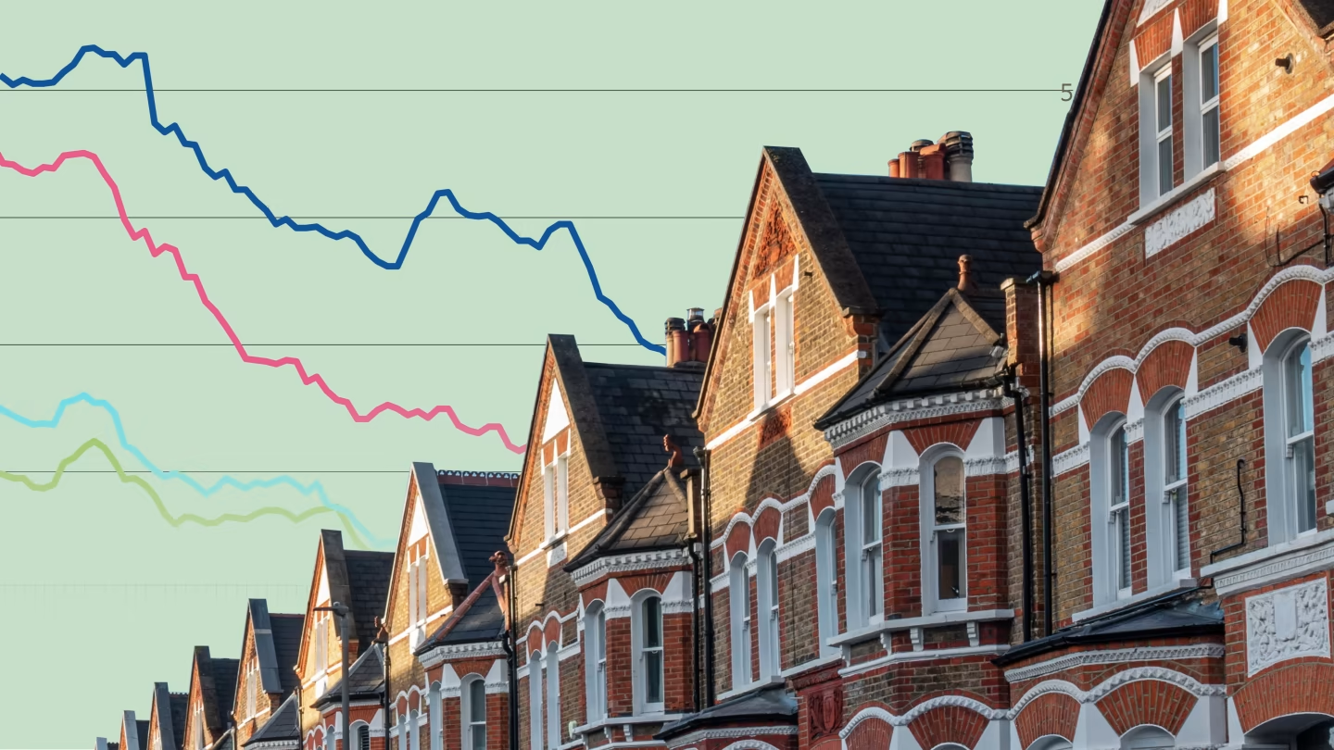
LONDON HOUSING:
MARKET ANALYSIS
MIS 6341.001 - Applied Machine Learning - S24

Slide 2





MEET OUR GREAT TEAM
Matthew Payte
Nithyashree Balaji
Claudia Bonon
Sarah Popal
Dániel Terényi

Slide 3
INTRODUCTION
OBJECTIVE: predict housing prices and classify affordability based on factors such as house prices, number of houses sold, salary, crime, and population density.
Housing prices globally are rising, emphasizing the need for a closer examination of specific markets.
London, with its inflated and challenging pricing dynamics, serves as a prime case study.
Additionally, clustering analysis will provide insights into the diverse housing choices within the London market.

Slide 4
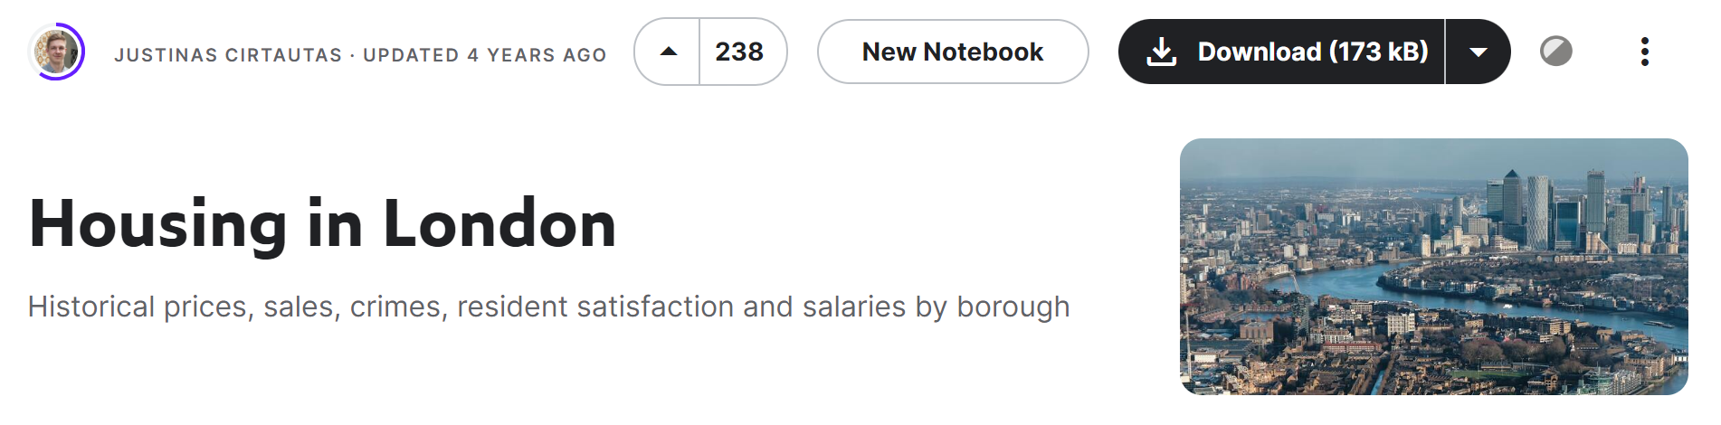
ABOUT THE DATASET
Found on Kaggle and gathered from the London government.
2 datasets
Variables:
Monthly average house prices
Yearly number of houses
Yearly number of houses sold
Yearly percentage of households that recycle
Yearly life satisfaction
Yearly median salary of the residents of the area
Yearly mean salary of the residents of the area
Monthly number of crimes committed
Yearly number of jobs
Yearly number of people living in the area
Area size in hectares

Slide 5
DATA
CLEANING

Slide 6
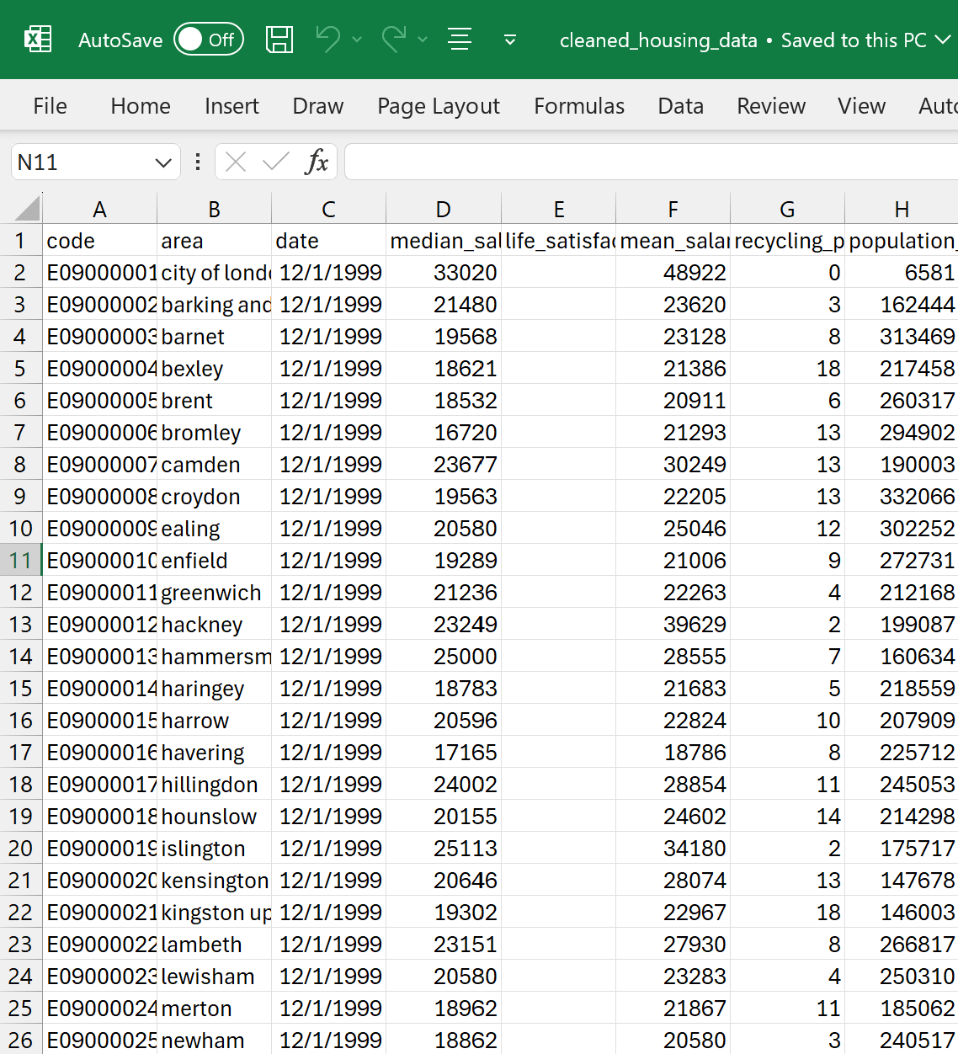
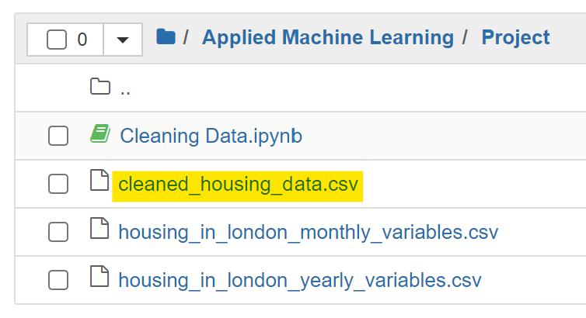
PYTHON CODE
Data set were pretty clean, we only needed to remove Blank spaces and random values.

Slide 7
LET’S SEE SOME
CHARTS

Slide 8
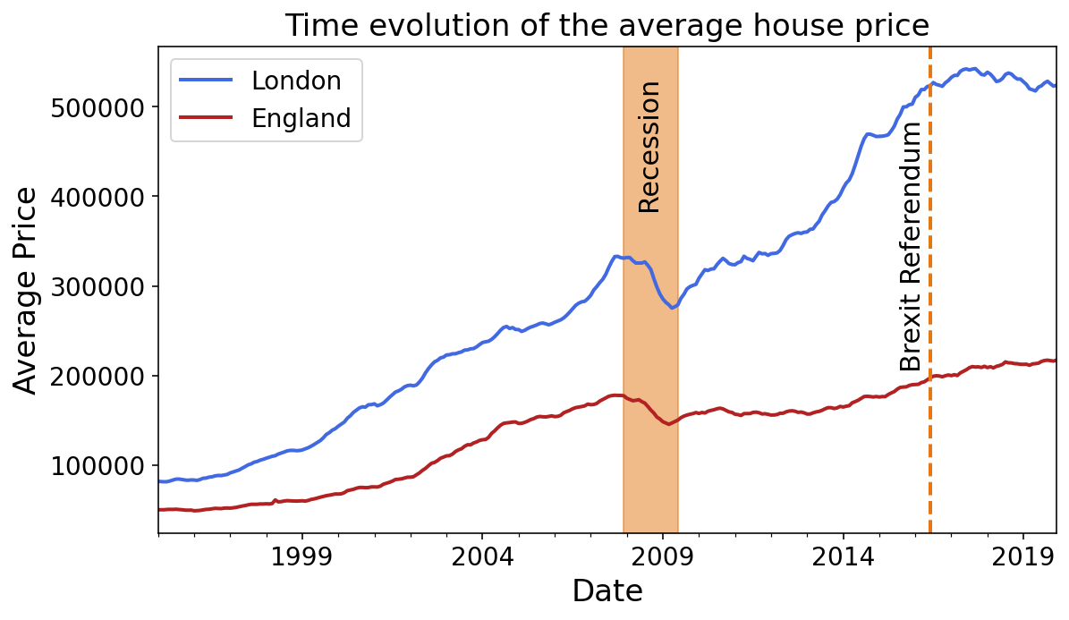
OVERVIEW OF HOUSING PRICES OVER TIME(1995-2020)
Plot showing the trend in average housing prices over the years.

Slide 9
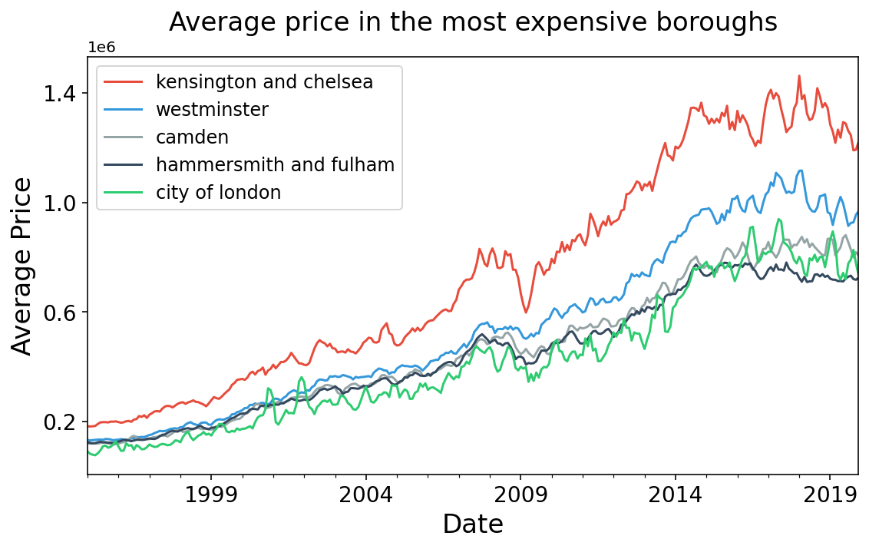
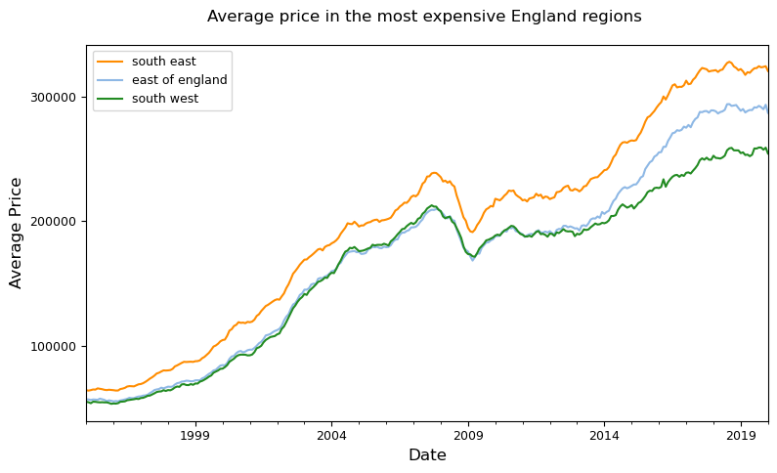
PRICE TRENDS BY BOROUGHS
Line chart depicting the price trends for select London and England boroughs over the years.
Expensive boroughs in London
Expensive boroughs Outside London

Slide 10
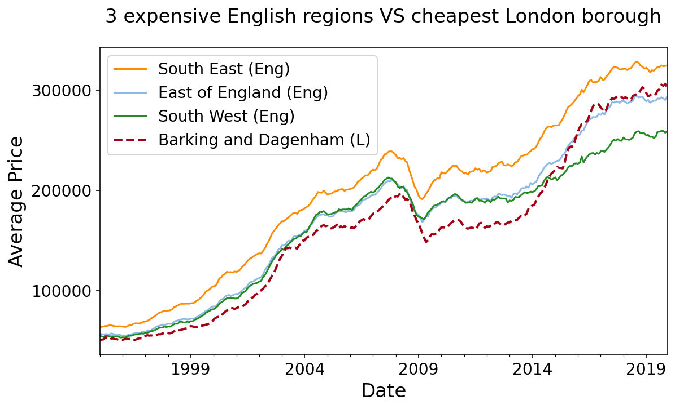
Regional Cost Disparities

Slide 11
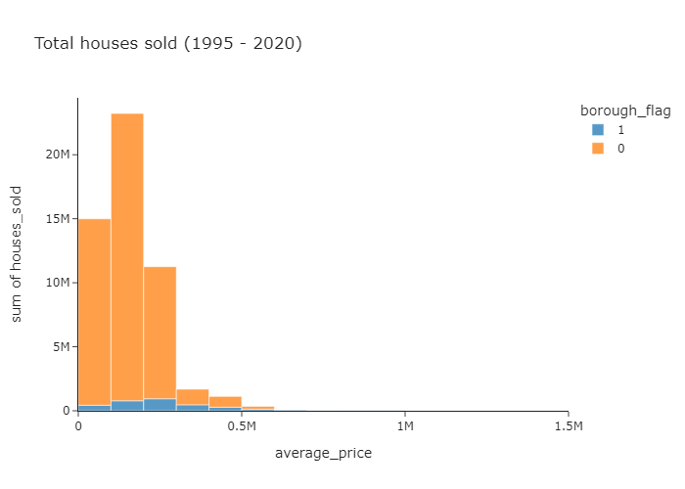
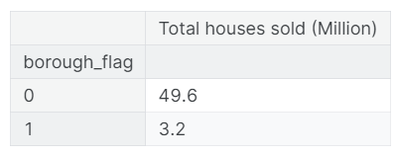
TOTAL HOUSES SOLD
Plot showing the trend in total houses sold over the years

Slide 12
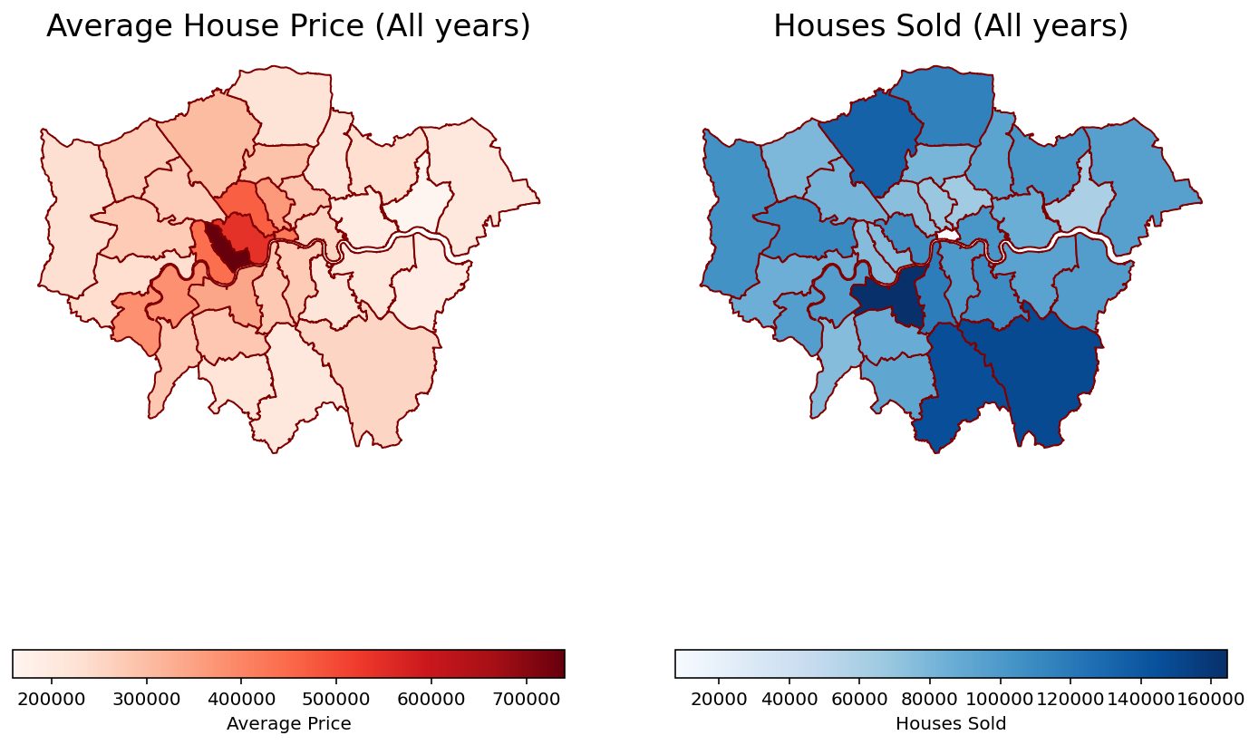
KEY AREAS FOR INCREASING SALES
Proximity to Expensive Boroughs
01
Kensington and Westminster stand out as the most expensive boroughs. Boroughs closer to these areas tend to have higher housing prices
02
Borough Size and Houses Sold
There is a clear relationship between borough size and the number of houses sold. Larger boroughs generally have a higher number of houses sold.

Slide 13
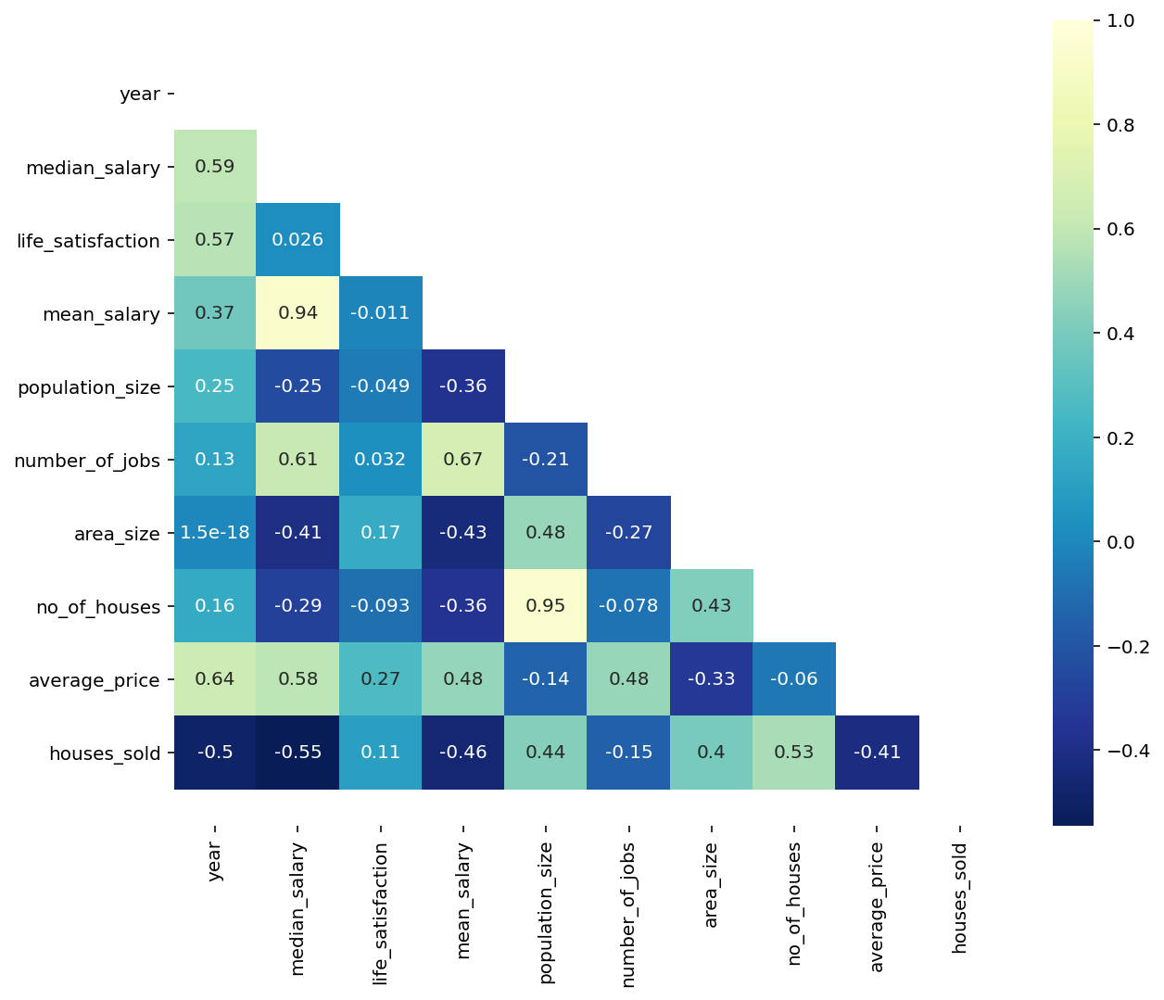
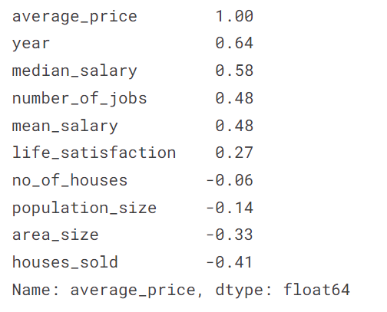
FACTORS AFFECTING HOUSING
Understanding the Drivers of Housing Price Fluctuations

Slide 14
Regression,
Regression,
Regression!

Slide 15
Regression Analyses
Steps, using Python:
Data Cleaning: Address null data and eliminate problematic predictors.
The dataset went from 13549 to 13455 records.
Conversion of Categorical Predictors to K-1 Dummy Variables
Models were built with 46 predictor variables.
Data Visualization
Histogram of average price distribution, heatmap of correlations
Split Dataset (70% training, 30% testing)
Build Models
Linear Regression, Lasso, Ridge, Decision Tree, and Random Forest regressors were considered.
Polynomial Regression was attempted, but high # of features made it too computationally inefficient for presentation purposes.
Compare Accuracies, identify best performing model.

Slide 16
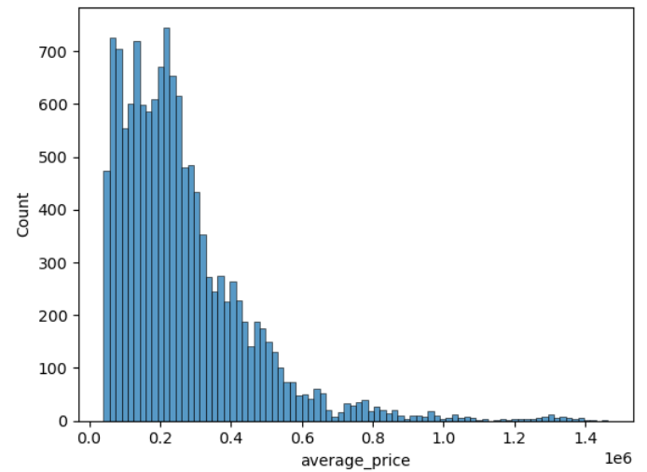
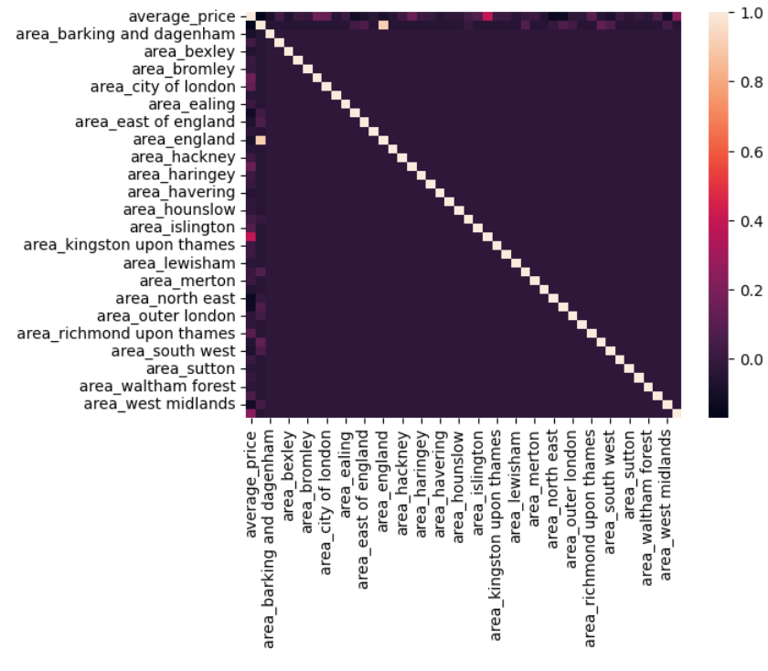
Visualization
A frequency histogram of the outcome of interest, average price of housing, was considered to explore the data.
A heatmap was considered to explore correlations between predictors.

Slide 17
Model Performances
Model | Training R^2 Score | Test R^2 Score | Best Gridsearch
Linear Regression | 0.4098995 | 0.3805054 | N/A
Polynomial | Too Computationally Demanding | Too Computationally Demanding | Too Computationally Demanding
Ridge | 0.4098994 | 0.3805083 | 0.4034508
Lasso | 0.4098995 | 0.3805054 | 0.4034507
Regression Tree | 0.4470087 | 0.4370932 | 0.4282369
Random Forest | 0.6620677 | 0.5813693 | N/A
Models were evaluated on the basis of accuracy, or their R^2 score.
The best performing model was Random Forest Regression with 500 trees and 1000 maximum samples.
Polynomial Regression was not feasible because the large number of features made it too computationally demanding to present in class in a timely manner.

Slide 18
Classification Analysis

Slide 19
Classification Overview
Data Collection and Cleaning
Model Training and Parameter Tuning
Collected data from two datasets: cleaned_housing_data.csv and housing_in_london_monthly_variables.csv and performed initial cleaning to handle missing values
Trained six different classifiers: Random Forest, SVM, and KNN, LogReg, Bagging, Adaboost + used grid search for hyperparameter optimization to enhance model performance
Data Merging and Preparation
Model Evaluation
Merged datasets based on common attribute ‘year’ and encoded categorical variables and standardized numerical data to prepare for modeling
Evaluated models based on accuracy, precision, recall, and F1 scores
Feature Selection and Engineering
Visualization and Analysis
Used correlation analysis and feature importance metrics from preliminary Random Forest models
Developed visualizations to compare model accuracies, display feature importance, and interpret the confusion matrix

Slide 20
Model Evaluation
Target Variable: "Affordability" — categorized into three classes ('Low', 'Medium', 'High') based on quartiles of mean salary to assess housing affordability in London
Features: Includes key variables such as 'Average Price', 'Houses Sold', 'No of Crimes', and 'Population Density'
 | Accuracy | PrecisionH | Recall H | F1-score H | PrecisionL | Recall L | F1-score L | Recall M | PrecisionM | F1-score M
Random Forest | 0.746 | 0.76 | 0.65 | 0.70 | 0.72 | 0.74 | 0.73 | 0.77 | 0.85 | 0.81
Linear SVM | 0.740 | 0.81 | 0.51 | 0.62 | 0.67 | 0.82 | 0.74 | 0.83 | 0.83 | 0.83
KNN | 0.718 | 0.78 | 0.63 | 0.70 | 0.69 | 0.70 | 0.70 | 0.72 | 0.83 | 0.77
LogReg | 0.525 | 0.38 | 0.61 | 0.47 | 0.53 | 0.31 | 0.39 | 0.74 | 0.77 | 0.75
Bagging | 0.746 | 0.75 | 0.73 | 0.74 | 0.73 | 0.69 | 0.71 | 0.76 | 0.85 | 0.80
Adaboost | 0.635 | 0.57 | 0.59 | 0.58 | 0.59 | 0.61 | 0.60 | 0.79 | 0.71 | 0.75

Slide 21
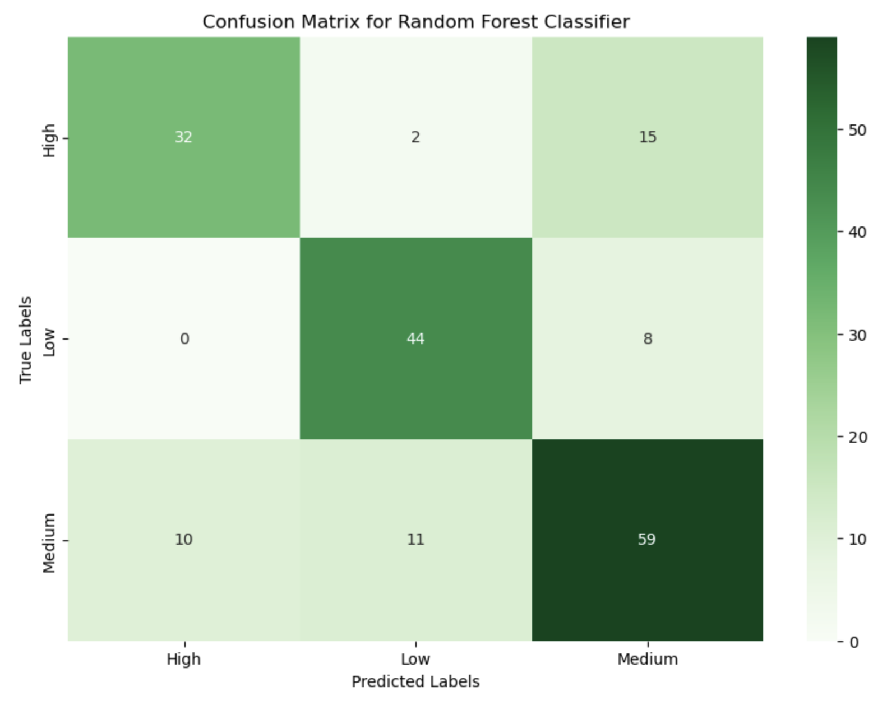
Random Forest Visualization
Analysis:
"Low" class: Strong performance with high true positives (44) and low false positives (8)
"High" class: Decent performance but notable false negatives (10), indicating room for improvement
"Medium" class: Highest false negatives (23), suggesting significant challenges in identification

Slide 22
Clustering Analysis

Slide 23
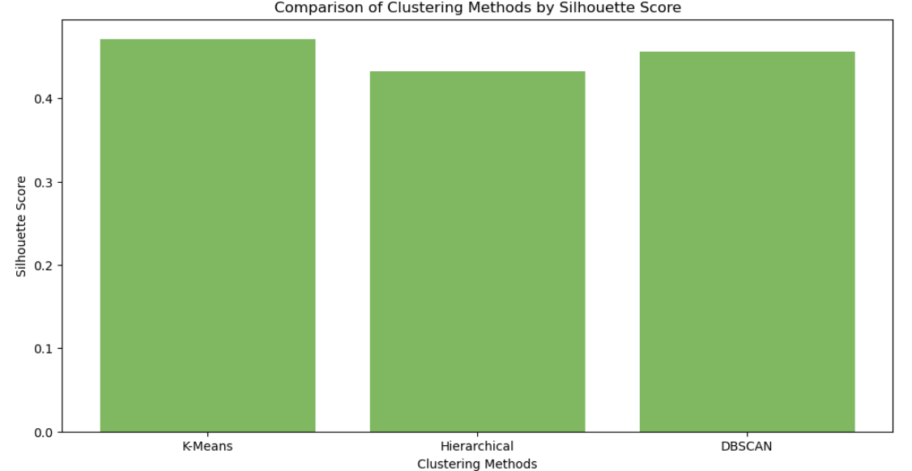
Clustering Method Visualization
Analysis:
Highest performance: K-Means demonstrated the highest silhouette score, indicating optimal cluster compactness and separation
Close competitors: DBSCAN excelling in handling outliers and Hierarchical useful for revealing nested data structures.
Selection: K-Means is preferred for distinct separations

Slide 24
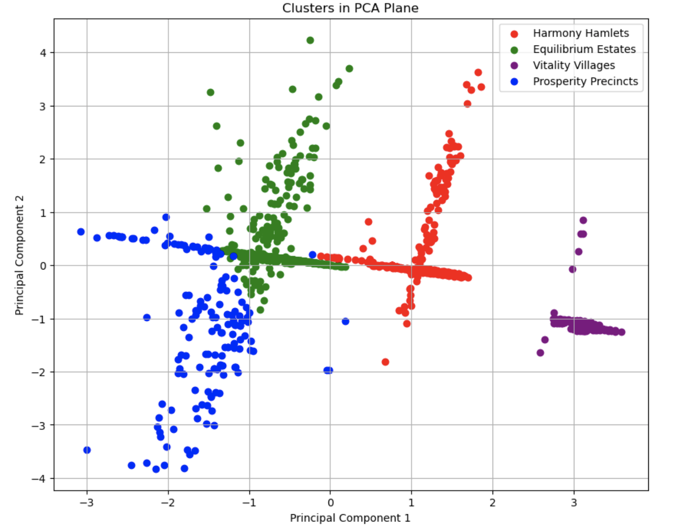
KMeans Deep Dive
Analysis:
Harmony Hamlets: Lower-income, suburban or semi-rural areas with high life satisfaction
Equilibrium Estates: Middle-income, balanced residential neighborhoods within boroughs
Vitality Villages: Densely populated, low-income urban areas with vibrant community life
Prosperity Precincts: High-income, sparsely populated areas within boroughs facing issues like social isolation

Slide 25
CONCLUSIONS
Summary highlighting the key findings and recommendations based on the analysis
The average house prices in London boroughs are influenced by the financial prosperity of the area, with higher salaries and more job opportunities leading to higher property prices
Borough size is positively correlated with the number of houses sold, indicating that larger boroughs tend to have a higher number of property transactions.
For both regression and classification the best performing model was Random Forest, with approximately 58.1% and 74.6% accuracy respectively.
In London's housing market, clustering revealed that higher income does not necessarily mean higher satisfaction, nor does lower income imply weak community bonds.
This underscores the role social cohesion and community amenities play in residents' wellbeing, challenging conventional assumptions about affluent areas and highlighting new economic trends as worldwide disparities increase.

